Slide 1
Javascript HTML DOM

Slide 2
The HTML DOM
With the object model, JavaScript gets all the power it needs to create dynamic HTML:
JavaScript can change all the HTML elements in the page JavaScript can change all the HTML attributes in the page JavaScript can change all the CSS styles in the page
JavaScript can remove existing HTML elements and attributes JavaScript can add new HTML elements and attributes JavaScript can react to all existing HTML events in the page JavaScript can create new HTML events in the page

Slide 3
The HTML DOM Document Object
The document object represents your web page.
If you want to access any element in an HTML page, you always start with accessing the document object.
Then you can do a lot of things with the document object:
Action | Example
Finding HTML Elements | document.querySelector(CSS selector);
Adding and Deleting Elements | document.createElement(element);
Changing HTML Elements | element.innerHTML = new html content;
Adding Events Handlers | element.addEventListener('event', handler);

Slide 4
FINDING HTML ELEMENTS

Slide 5
Finding HTML Elements
If you want to find the first HTML elements that matches a specified CSS selector (id, class names, types, attributes, values of attributes, etc), use the querySelector() method.
For example this javascript statement will return the first paragraph element of class main:
<body>
<p>my first paragraph</p>
<p class="main">my first main paragraph</p>
<p class="main">my second main paragraph</p>
document.querySelector("p.main");
<a href="http://www.google.com">google</a>
</body>

Slide 6
Finding HTML Elements
If you want to find all HTML elements that match a specified CSS selector (id, class names, types, attributes, values of attributes, etc), use the querySelectorAll() method.
For example this javascript statement will return all paragraph elements of class main:
<body>
<p>my first paragraph</p>
<p class="main">my first main paragraph</p>
<p class="main">my second main paragraph</p>
document.querySelectorAll("p.main");
<a href="http://www.google.com">google</a>
</body>

Slide 7
Finding HTML Elements
querySelectorAll() method will return a list of all HTML elements that match the specified CSS query.
const pars = document.querySelectorAll("p.main");
<body>
<p>my first paragraph</p>
pars[0]
<p class="main">my first main paragraph</p>
pars[1]
<p class="main">my second main paragraph</p>
<a href="http://www.google.com">google</a>
</body>

Slide 8
ACESSING AND FINDING ELEMENTS
GET ELEMENT BY ID
GET ELEMENT BY CLASS NAME
GET ELEMENT BY TAG NAME

Slide 9
Accessing and finding elements: (document.getElementById)
document.getElementById returns the DOM object for an element with a given id
can change the text inside most elements by setting the innerHTML property

Slide 10
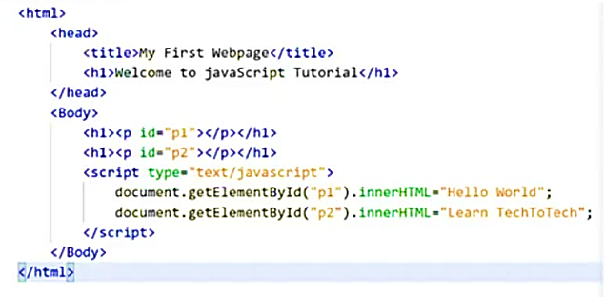

Slide 11
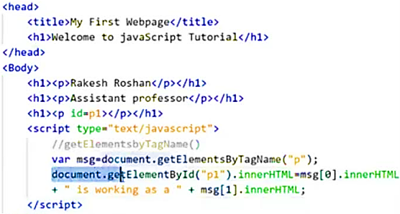
HTML GET ELEMENTS BY TAG NAME

Slide 12
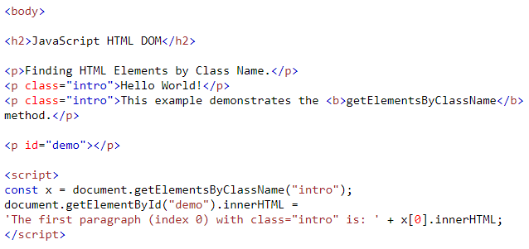
HTML GET ELEMENTS BY CLASS NAME

Slide 13
CHANGING HTML ELEMENTS

Slide 14
Changing HTML Elements
The HTML DOM allows JavaScript to change the content of HTML elements.
The easiest way to modify the content of an HTML element is by using the
innerHTML property.
To change the content of an HTML element, use this syntax:
This is the element you want to change the html inside of it
this is the new html code or text you want to put inside the element
element.innerHTML =
new HTML

Slide 15
Changing HTML Elements
For example this javascript code changes the text inside the h1 element:
let header = document.querySelector("h1"); header.innerHTML = "My new heading";
<h1>My old heading</h1>
<h1>My new heading</h1>

Slide 16
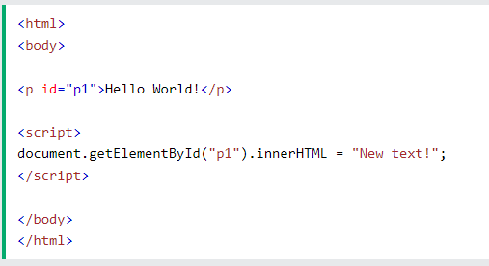
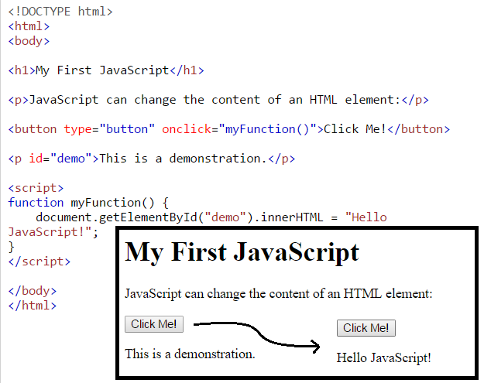
CHANGING HTML CONTENT
FOR EXAMPLE

Slide 17
Changing HTML Elements
You can also change the value of an HTML attribute.
This is the element you want to change an attribute of
element.attribute =
new value
this is the new value you want to assign to the specified attribute of the given element
This is the attribute you want to change

Slide 18
Changing HTML Elements
For example this javascript code changes the href attribute of an <a> element with id myLink:
let myLink = document.querySelector("#myLink"); myLink.href = "http://www.newwebsite.com";
<a href="http://www.oldwebsite.com" id="myLink">A link to my website</a>
<a href="http://www.newwebsite.com" id="myLink">A link to my website</a>

Slide 19
Changing CSS styles
To change the style of an HTML element, use this syntax:
document.getElementById(id).style.property = new style

Slide 20
Changing element style: element.style
Attribute | Property or style object
color | color
padding | padding
background-color | backgroundColor
border-top-width | borderTopWidth
Font size | fontSize
Font famiy | fontFamily

Slide 21
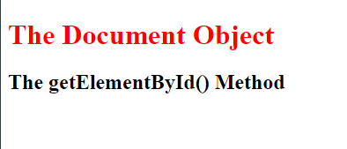
Example 2
<html>
<body>
<h1 id="demo">The Document Object</h1>
<h2>The getElementById() Method</h2>
<script>
const myElement = document.getElementById("demo");
myElement.style.color = "red";
</script>
</body>
</html>

Slide 22
Change styles on button click
<!DOCTYPE html> <html> <body> <h1 id="id1">My Heading 1</h1> <button type="button" onclick="document.getElementById('id1').style.color = 'red'"> Click Me!</button> </body> </html>

Slide 23
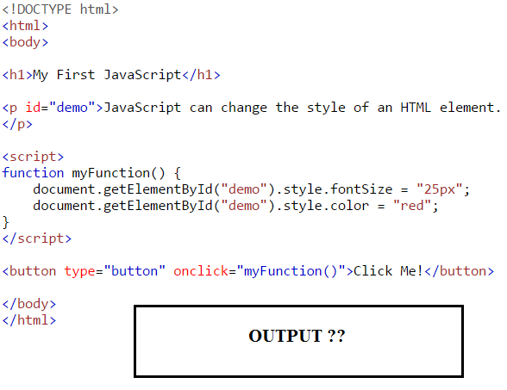
2. Changing HTML Styles

Slide 24
Javascript DOM Events
Javascript can react to HTML DOM events
To achieve this we have to add an event listener that fires when a user causes any event e.g. clicks a button
element.addEventListener(event, eventHandler)
This is the element you want to capture the events on
This is the event you want to capture e.g. 'click' or 'mouseover'
This is the name of the function you want to call when the event is fired

Slide 25
Javascript DOM Events
You can add many eventHandlers for the same or different events to the same element:
const element = document.querySelector("button");
element.addEventListener('click', function1); element.addEventListener('click', function2); element.addEventListener('keyup', function3);

Slide 26
Javascript DOM Events
You can also remove event handlers that have been attached with the addEventListener() method:
element.removeEventListener(event, eventHandler)
This is the element you want to remove the eventListener from
This is the event name you want to remove the eventListener for
This is the name of the function you have used as the eventHandler for the eventListener you want to remove

Slide 27
Javascript DOM Events
const element = document.querySelector("button");
element.addEventListener('click', function1); element.addEventListener('click', function2); element.addEventListener('keyup', function3);
//This removes the second eventListener for 'click' element.removeEventListener('click', function2);

